Slide 1

UIDAI Hackathon
Team Reference ID : hvkmfTgfVL
Team Name : runtime_terror
Team Member Details
Sl No | Name | E Mail ID
1 | Rajarshi Ghosh Dastidar | rajarshighoshdastidar@gmail.com
2 | Anupam Samanta | anupam96786@gmail.com

Slide 2
About the Problem Statement
Theme : Authentication Reimagined
Problem Statement:
PS3 - Use of Aadhaar as additional factor in 3rd party transaction
Use the services of Aadhaar to securely conduct high value transactions in third party apps without compromising the privacy of the resident.
Can we get a “token” (digitally signed authentication response) from an Aadhaar auth from online face auth on the resident mobile and later use this token as an additional (second) factor of authentication in a third-party application.

Slide 3
Terminology Used
Resident Application:
Web Application which provides an Single Sign In interface with the help of Aadhar’s APIs.
Avail auth products of UIDAI
Facilitates secure communication b/w UIDAI & residents
Privacy should be utmost priority, Aadhaar number should not be preferred
Verifier Application:
3rd party app using UIDAI services for validating claims of residents

Slide 4
Approach
Aadhar-SSO for third party applications.
With AADHAR being a primary mode of identity and authentication for all Indian citizens, we wanted to create a process to provide a “Login” or “Register” with Aadhar for 3rd Party Websites and Applications. It will be a process where 3rd party apps and websites can integrate a script provided by us in order to login the user automatically with the help of the resident app’s apis.

Slide 5
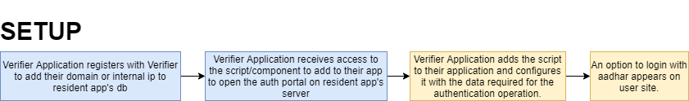
Diagrams

Slide 6
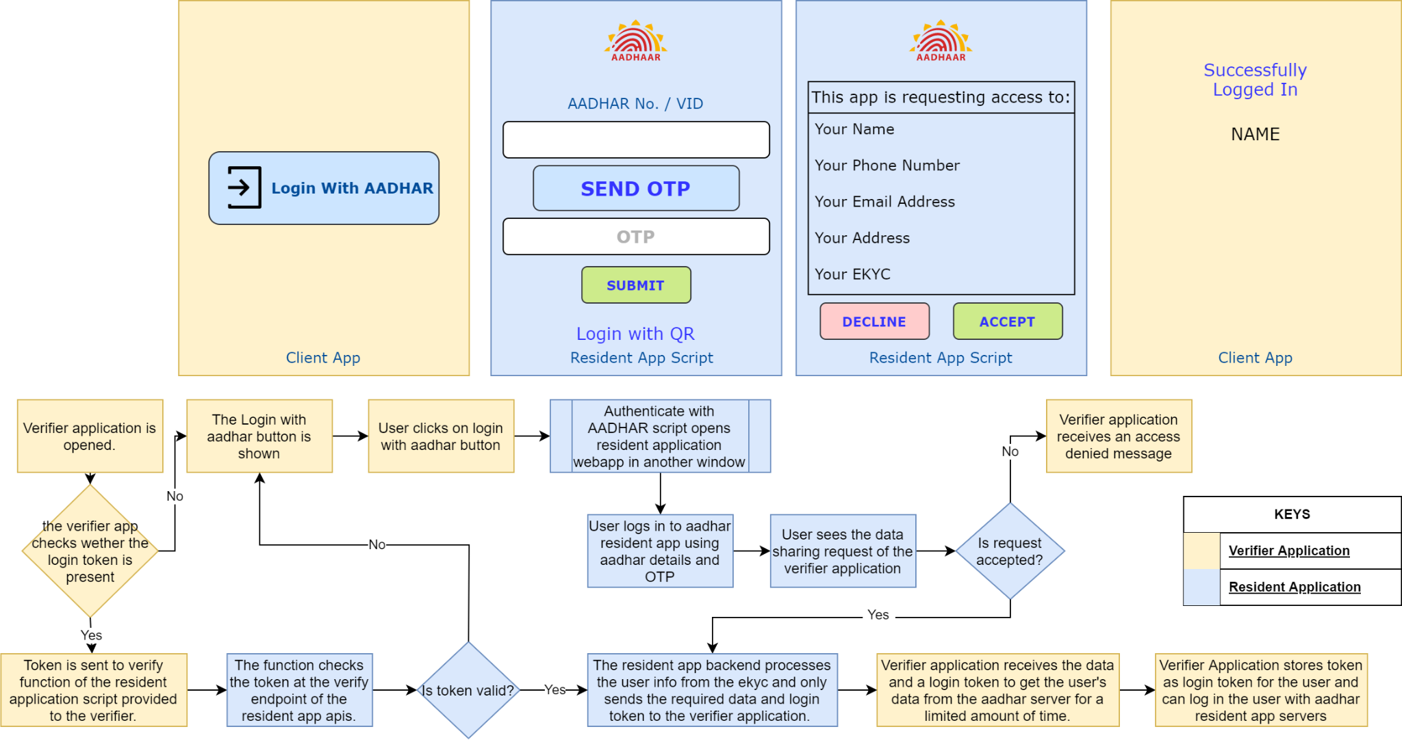
Architectural Diagram

Slide 7
API Usage
VID Wrapper API
E-KYC API
Auth API

Slide 8
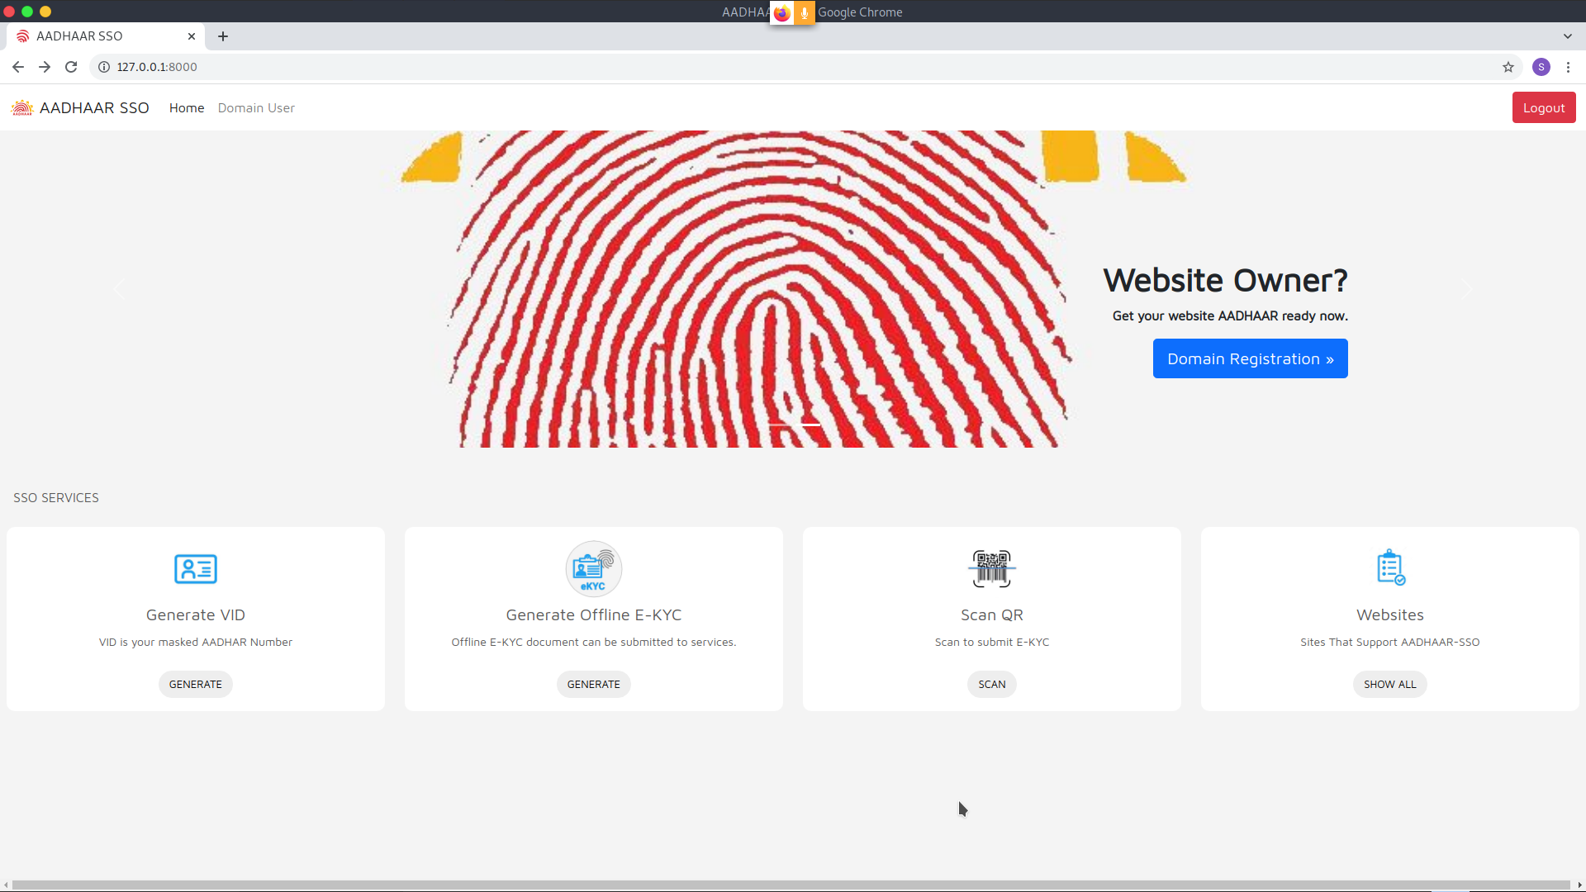
Home Screen

Slide 9
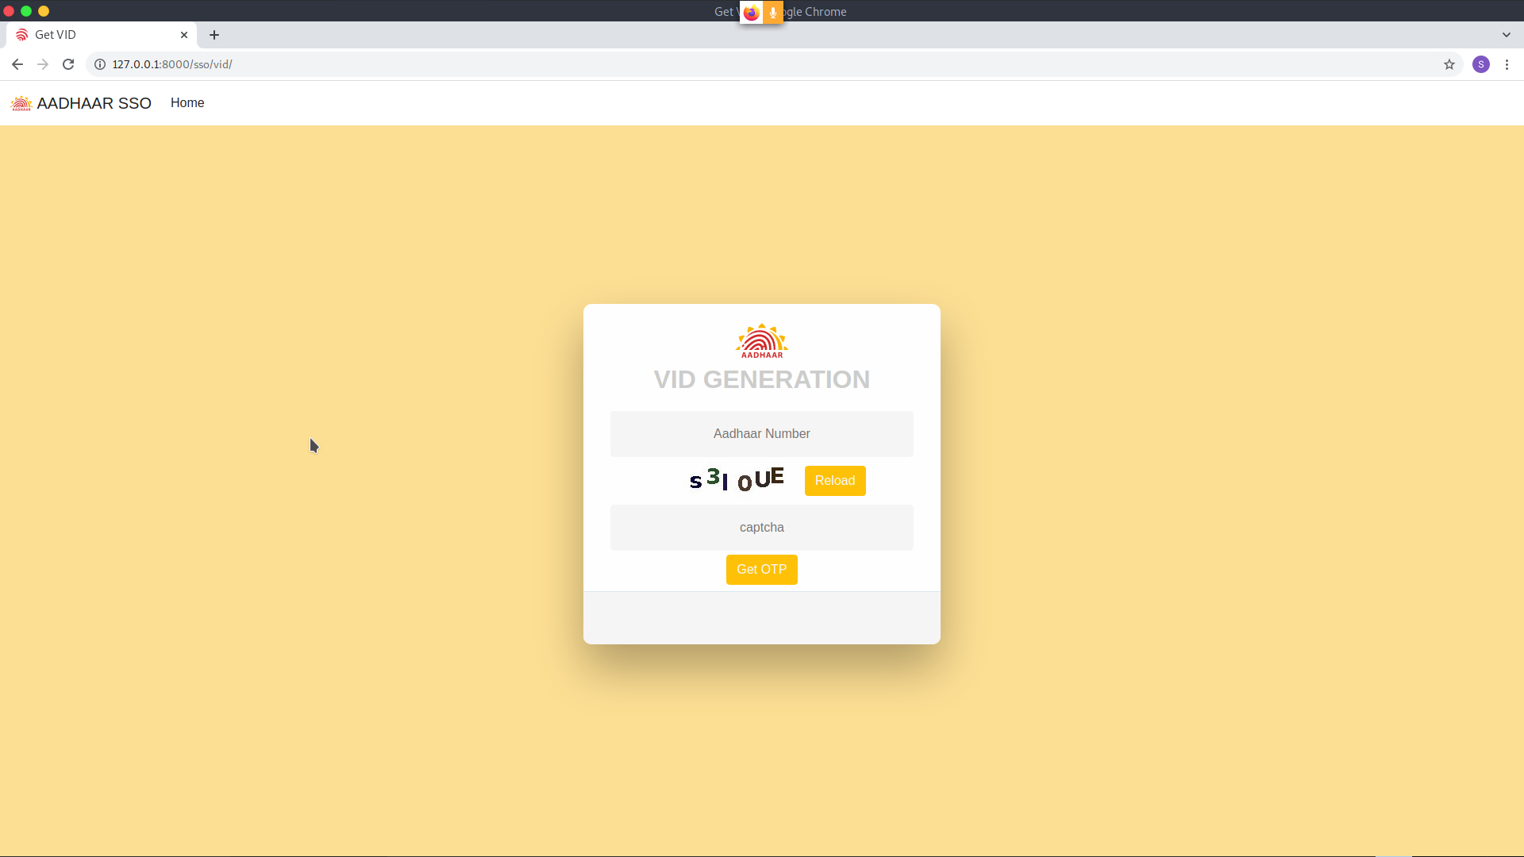
Functionalities
VID - User will be able to generate a vid by entering his Aadhaar number. After that the vid can be used to other domains and the user doesn’t need to use his or her aadhaar number everywhere

Slide 10
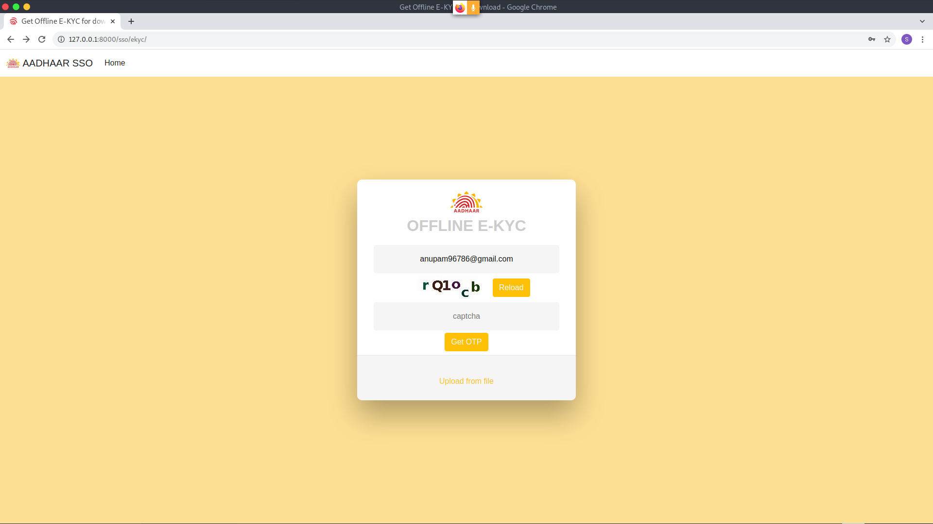
Functionalities
Offline EKYC Generator - User can download the Offline ekyc file and use that.

Slide 11
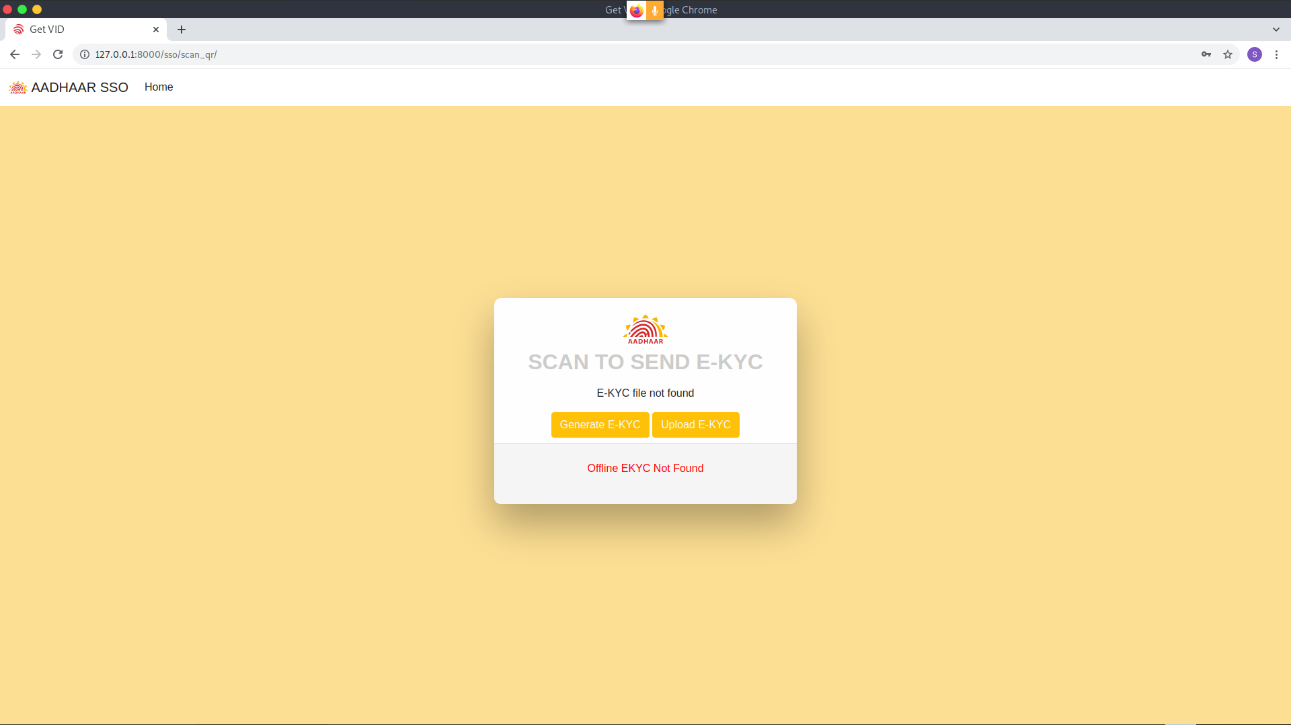
Functionalities
Scanning QR - User can scan the QR code provided by a verifier app and share his/her details without sharing his aadhaar number

Slide 12
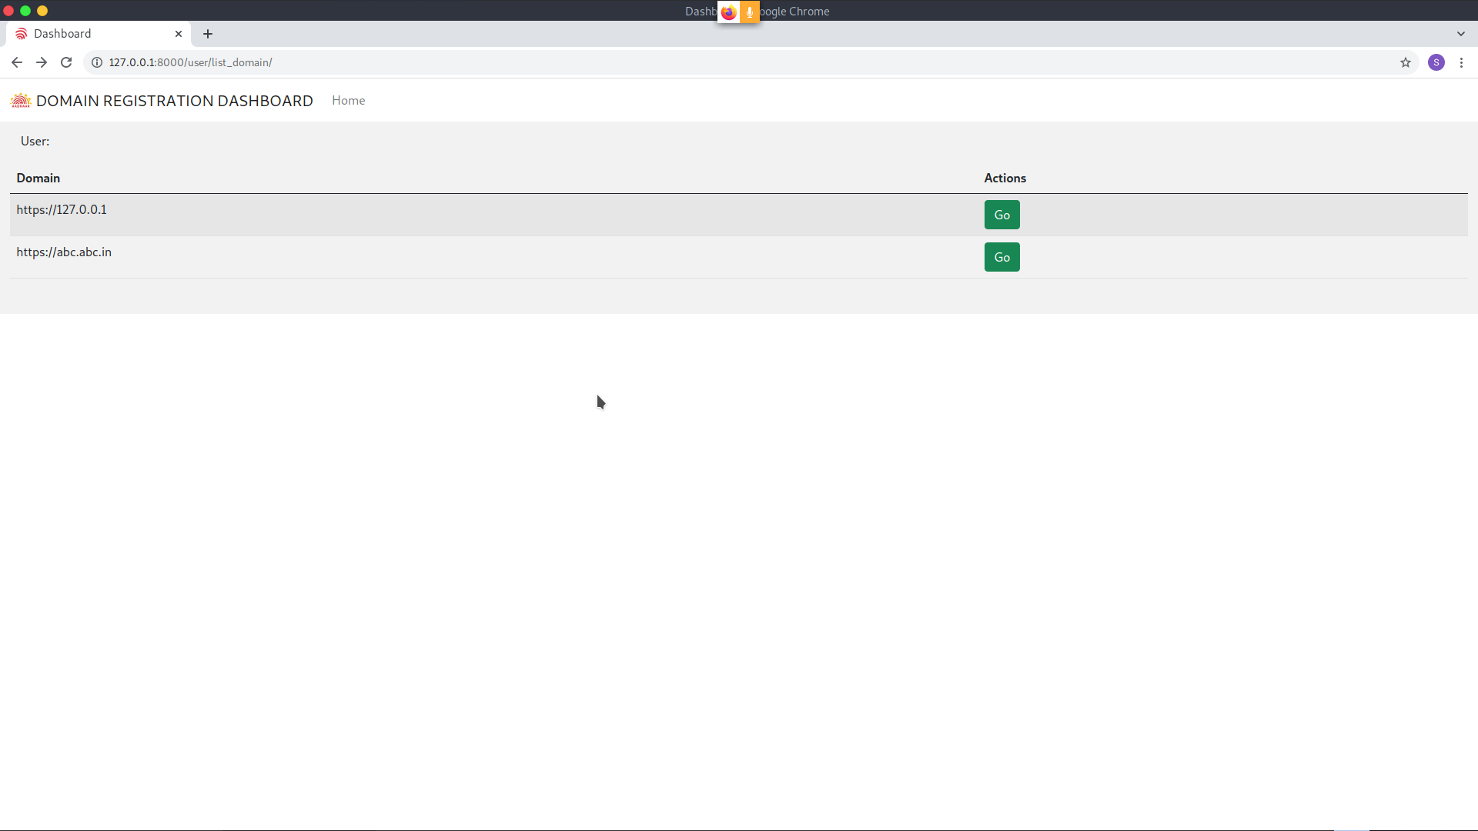
Functionalities
List Domains - User can see the list of domains those are connected to our services

Slide 13
Functionalities
Domain Registrations - Verifies apps have to register their domains to use our services.

Slide 14
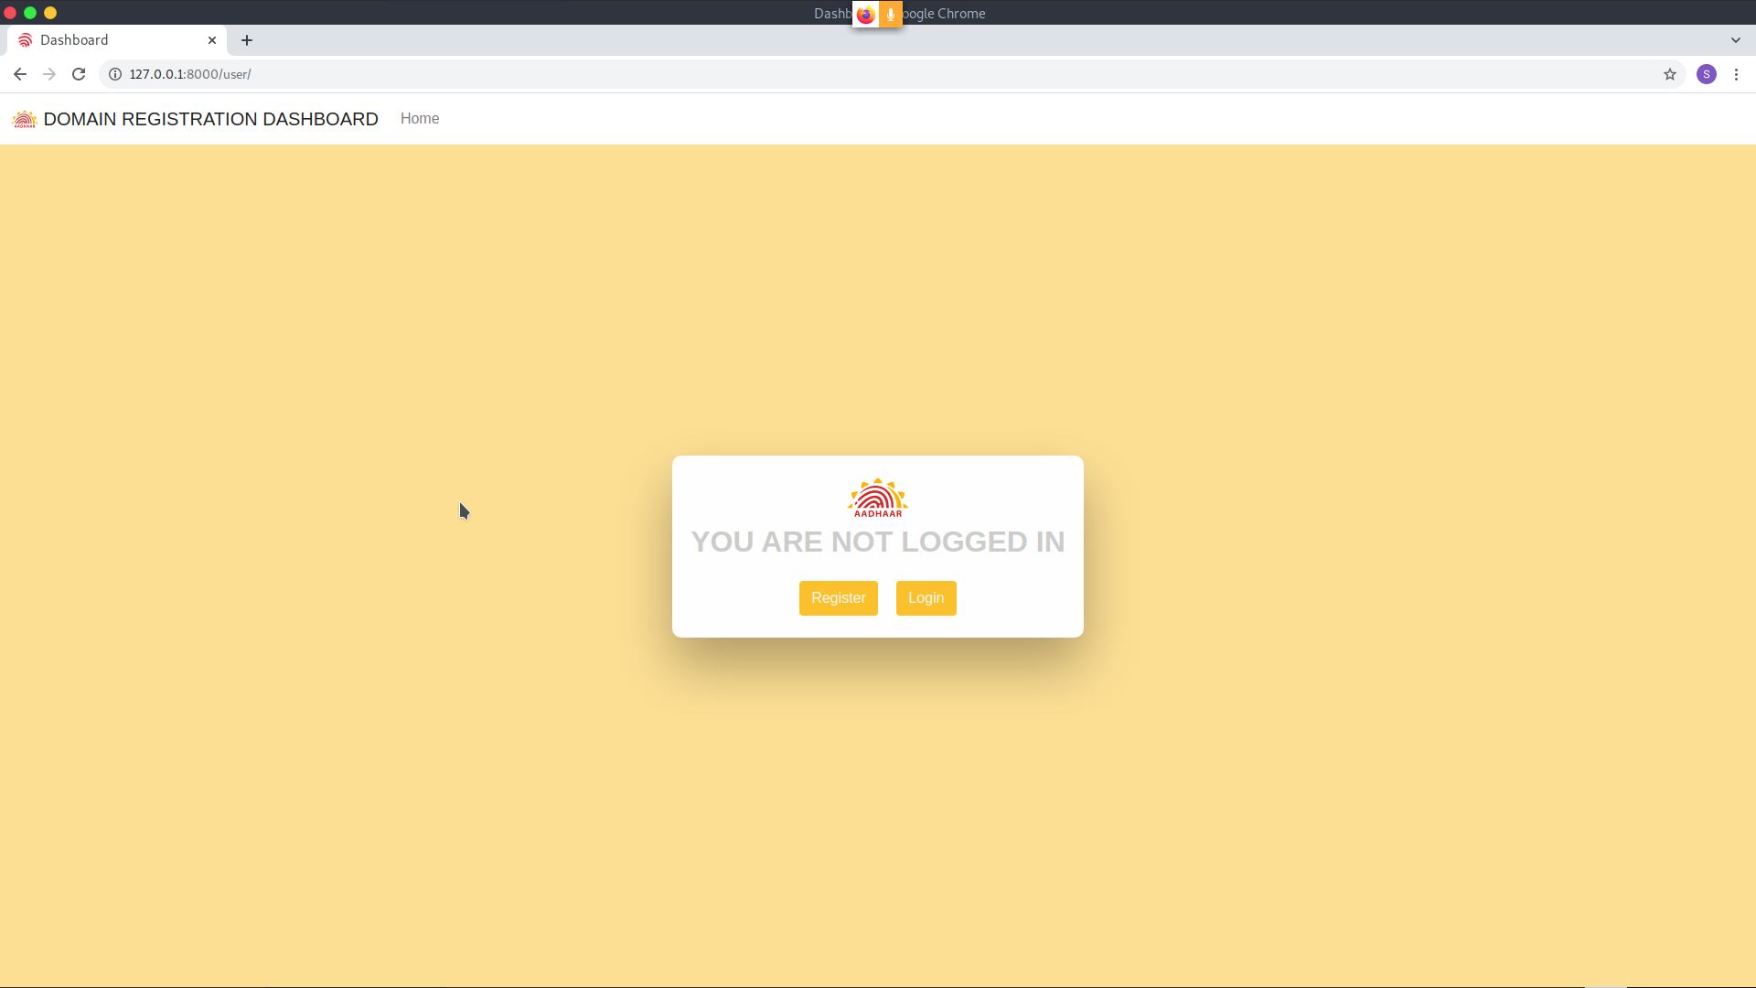
Functionalities
Domain Dashboard - Verifier can manage all of their registered domains easily

Slide 15
Security Considerations
In this authentication process the verifier application doesn’t directly communicate with aadhar server.
The resident application provides granular control to the user over the data requested by the verifier and shares only user consented data for a limited period of time until the token expires.
The Verifier application must register in the resident app in order to use the service.They must verify their domain and internal ip used to send the requests to the resident app server in order to use the service.
The resident application doesn’t store user data. It communicates with the aadhar apis to get the user data in the backend and sends only the consented data to the verifier.
The verifier may ask for the e-kyc document from the resident app and perform face and biometric verification in order to secure additional transactions.

